Slide 1
PLM/Product Lifecycle Management
Victor Gurov

Slide 2
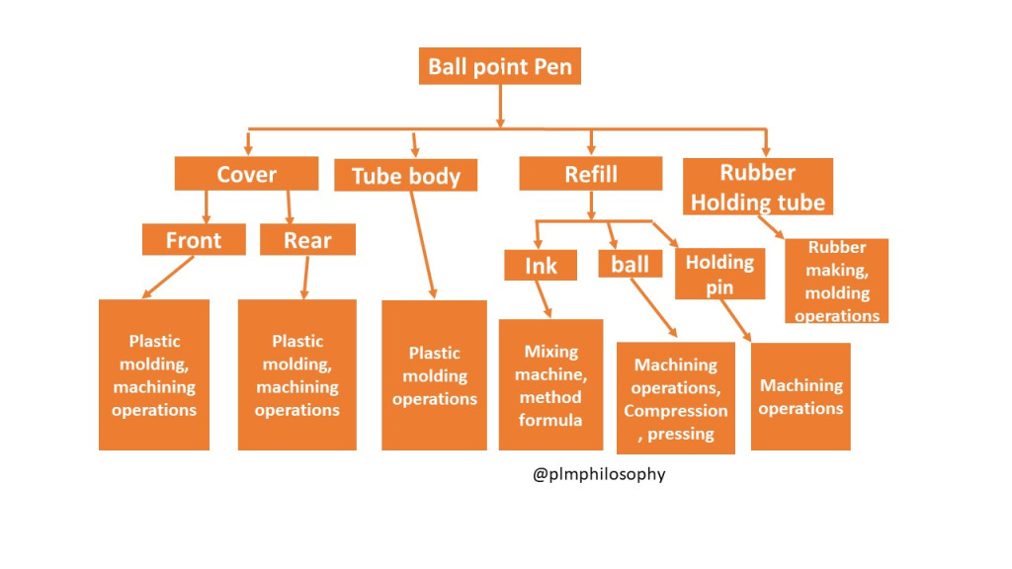
What is BOM?
A bill of materials (BOM) is a comprehensive inventory of the raw materials, assemblies, subassemblies, parts and components, as well as the quantities of each, needed to manufacture a product. In a nutshell, it is the complete list of all the items that are required to build a product.

Slide 3
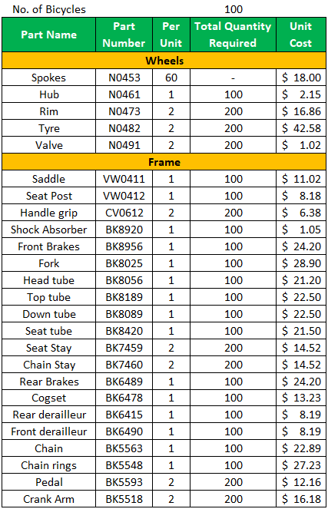
What is included in a bill of materials?
It includes all alternative and substitute part numbers and parts contained in the drawing notes. Every line of the bill of materials (BOM) includes the product code, part name, part number, part revision, description, quantity, unit of measure, size, length, weight, and specifications or features of the product

Slide 4
Why is the bill of materials important?
It serves as the core of any manufacturing process because it lays out all information required to assemble a part. Not only does a BOM outline what manufactured and raw materials are needed to build a part, but it also includes the equipment and tools needed to build the parts.

Slide 5
BOM Assignment
You need to choose a BOM level first, then you will create and explain why you have choose it, and which step you going to use it:
Manufacturing Bill of Materials (mBOM) ...
Engineering Bill of Materials (eBOM) ...
Service BOM. ...
Sales BOM. ...
Assembly Bill of Materials. ...
Production BOM. ...
Template Bill of Materials. ...
Configurable BOM (cBOM)
ETC

Slide 6
BOM Assignment
Assignment should contain:
BOM
Information about type of BOM you have picked.
What kind of task this BOM should solve (in manufacturing, sales, engineering and other processes).
Explain the details around this BOM: who/where/when will use this BOM (provide details on those steps which leads to using this BOM and provide what kind of result)

Slide 7
Good BOM should include:
BOM level
Part number
Part name
Phase
Description
Quantity
Unit of measures
Procurement type
Notes
ETC (depends on type of BOM)

Slide 8
Key Questions to Answer When Creating a BOM
Are There Consumables That Need to Be Itemized?
Are There Files That Must Be Attached to Your BOM?
Who Will Use the BOM?
How Will You Track BOM Revisions?

Slide 9

Providing Assignment Format
Teacher awaiting for your assignments in two files
Explanation file in .doc format or related and available for coping
BOM File in .xls or other database related format available for editing (non graphic)
If you are looking for some extra points for this class
Provide a graphic explanation on how does your BOM connected to the whole manufacturing process (where is this BOM in hierarchy of the main product) in .ppt or other related graphical format

